Slide 1
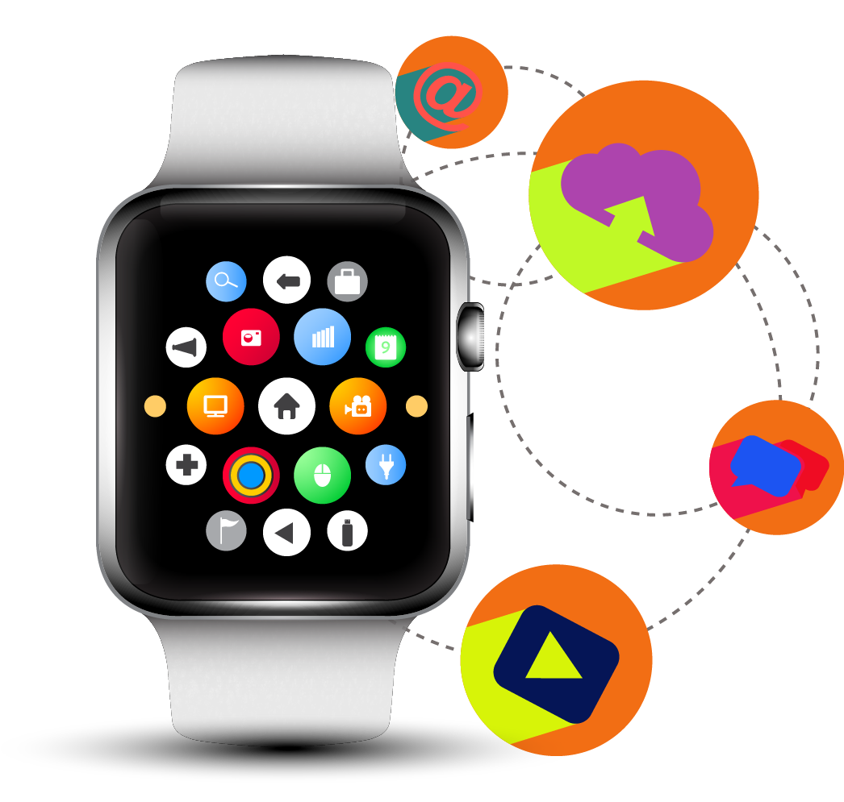
Wearable Technology
Barometer
Wearable Technology
Barometer

Slide 2
about wearable technology we can’t afford to miss
12Things
A Quick Overview

Slide 3

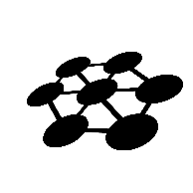



1) Wearable forms an integral part of IoT Ecosystem, making SENSE out of the Ecosystem
Wearable are amalgamation of one or more sensors empowered with computational capabilities, which captures and analyzes user’s data and has a capability to connect to the internet, enabling communication between a network and a device. Wearable technologies present a significant opportunity for businesses, both in terms of new markets and data collection. This is how Wearable makes SENSE out of the IoT Ecosystem.
SENSING
EFFICIENT
NETWORKED
SPECIALIZED
EVERY WHERE
EFFICIENT
Leverage
sensors
Attached
to things
Adds
Intelligence
to manual
process
Connects
objects to
the network
Customizes
Technology &
process to
specific verticals
Deployed
pervasively
Services

Slide 4
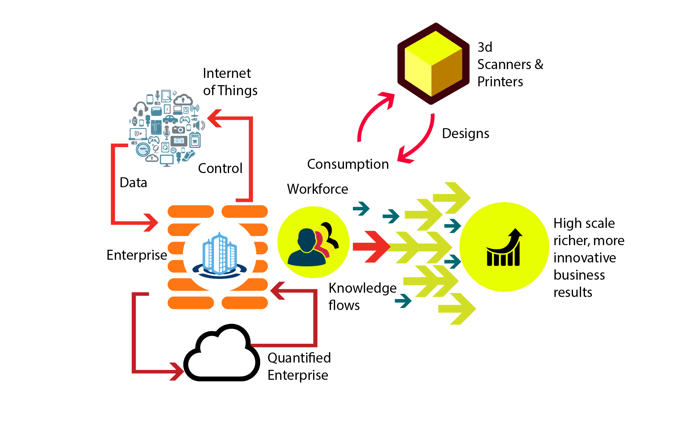

Wearable Technologies : Integrated part of IoT
The “thing” can be
A person with a heart monitor implant, a farm animal with a biochip transponder
Any other natural or man-made object
that can be assigned an IP address
An automobile that has built-in sensors to alert the driver when tire pressure is low

Slide 5


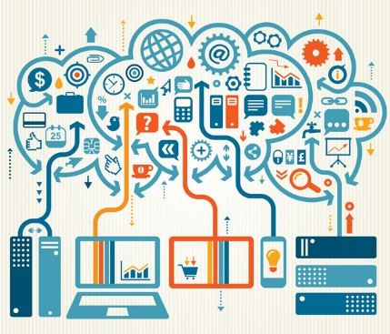
2) IoT Ecosystem & Trends
Internet of Things
Analytics/Social Business
Security
Applications
Privacy Concerns,
Insufficient
Authentication
/Authorization,
Transport Encryption,
Web Interface,
Insecure Software
Connectivity
Platforms
  Device, network & application enablement
Intelligent Systems
Services

Slide 6

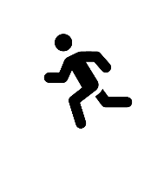



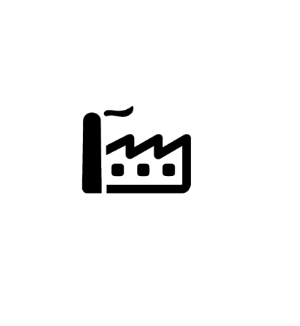



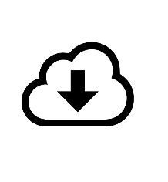


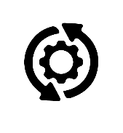




3) Value Chain Network & Key Player analysis
Industry Verticals
Medicine &
Healthcare
Infotainment
Clothing & Lifestyle
Gaming
Sports & Fitness
Key Players
Sensors/
Chips/Processors
Gateway/
Device Manufacturers
Connectivity
Providers
Enabler/Aggregator/
Cloud Services
Module Providers
Solution Providers
Authentication
/Testing
& Certifications
Regulatory
Bodies & Government
Application
Provider
Advance
Intelligence Solutions
System Integrator
Data Security

Slide 7
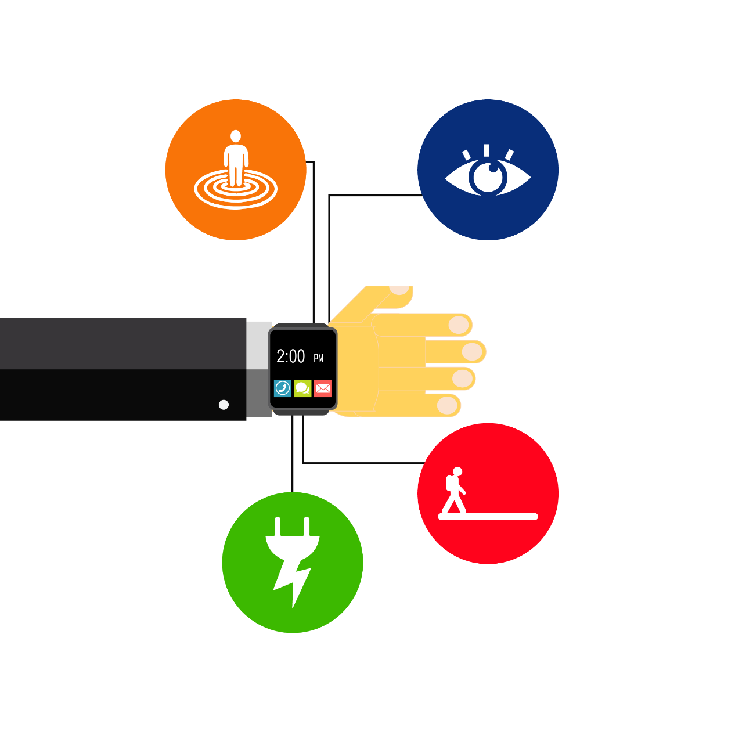
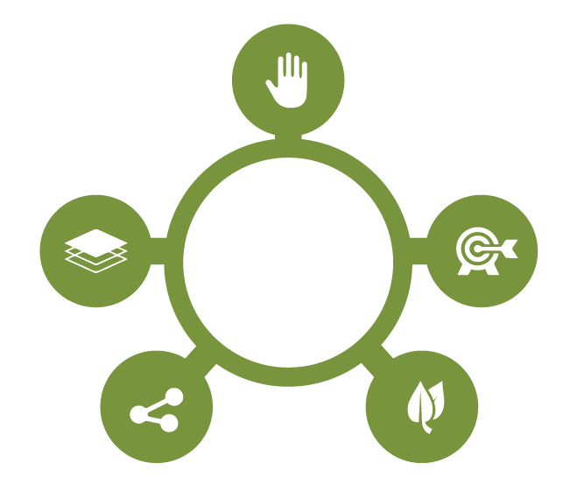
4) How Wearable is different from other verticals of IoT and the next Big Thing!!
Hands free ,
less distraction
User centric
Aesthetic
appeal of
trendy
fashions
Development Platform
3rd Party Apps
Accessories
API partners
Always on
Low power
consumption
Instant Wake
Background
Sensing
Must be
Integrated
Into the users
daily life
Environment
Aware
Connected
Small, durable,
energy efficient&
cost effective
GPS Microphone
Camera Accelerometer
Compass Other sensors
.Voice/Gesture Control
Less distracting while
receiving alerts

Slide 8

5) Wearable Technology : Why now???
A hefty
52 %
of people recently polled said they're aware of wearable technology devices
The Wearable
Technology market
was valued to be
$6.3 Million in 2010, $5.1 Billion
in 2014 and by 2018
is predicted
to surpass $12.6 Billion (Head Tech)
29%
of wearables
owners make over
$100,000 per year
Google glass
adoption will
climb sharply
to 21 million
units sold
in annual sales by
year-end
2018
Today, wearable
technology is a
$700 million
industry in the
form of sports And
activity trackers
71%
Of Americans say the wearable technology has improved their health (Rackspace)
61%
of all devices in the wearable tech market are activity or fitness trackers (ABI Research)

Slide 9
Wearable Technology : Why now???
Internet Boom: More & more people connected online
Cheap sensors: 60% 60% price in last 10 year
Cheap Bandwidth: in cost by a factor of 40X approx.
Cheap processing: in cost by a factor of 60X approx.
Smartphones: Serving as remote control for connecting devices
Ubiquitous wireless coverage: available for free / at low cost
Big Data: Analysis of voluminous amounts of unstructured data
IPv6: 32-bit address, translates to about 4.3 billion address

Slide 10

6) Market Segmentation of Wearable
2014 ||
2018 ||
Consumer applications are the largest component of the overall market. BCC Research published the most comprehensive study on the topic, projecting the market to grow from $6 billion in 2014 to $22.1 billion in 2018. The non-consumer market accounts for the rest: $3.2 billion in 2014 and $8.1 billion in 2018
$ 30.2Billion
$ 9.2 Billion
Wearable Market
Consumer (65% )
Non – Consumer ( 35%)
Applications
Applications
General Consumer (42%)
Fitness and Sports (40%)
Gaming and Rec (10%)
Home Automation (5%)
Fashion and Apparel (2%)
Healthcare (34%)
Defense & Security (31%)
Enterprise and Industry (34%)

Slide 11
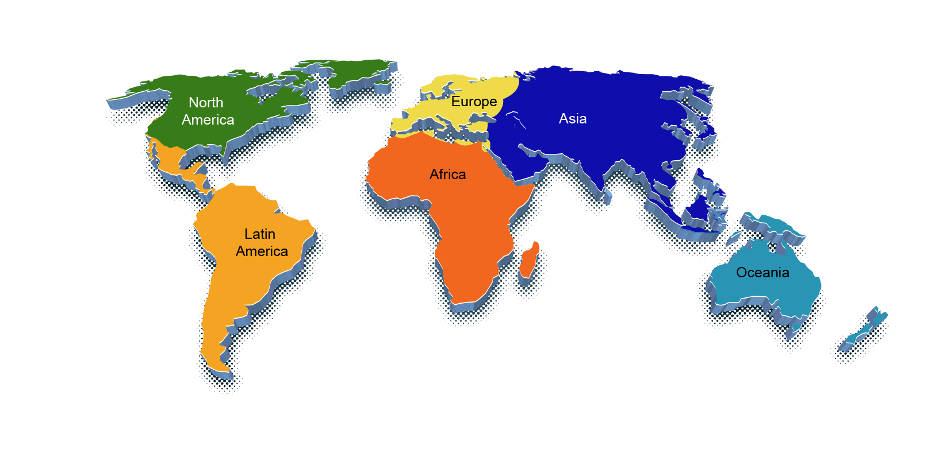
7) Adoption rate Geographically
Adoption Rate in Europe : 23%
Exhibit growth potential
Germany and the U.K. dominate the market
Adoption Rate in Asia Pacific: 27%
Fastest growing region
Technological advancements in APAC region
Low production cost in India and China
Adoption Rate in North America : 45%
Dominates the market
Technological advancements
Adoption Rate in ROW (Rest of the World): 5%
Expected to witness growth
Increased demand of wearable technology in Middle East and Latin American regions

Slide 12
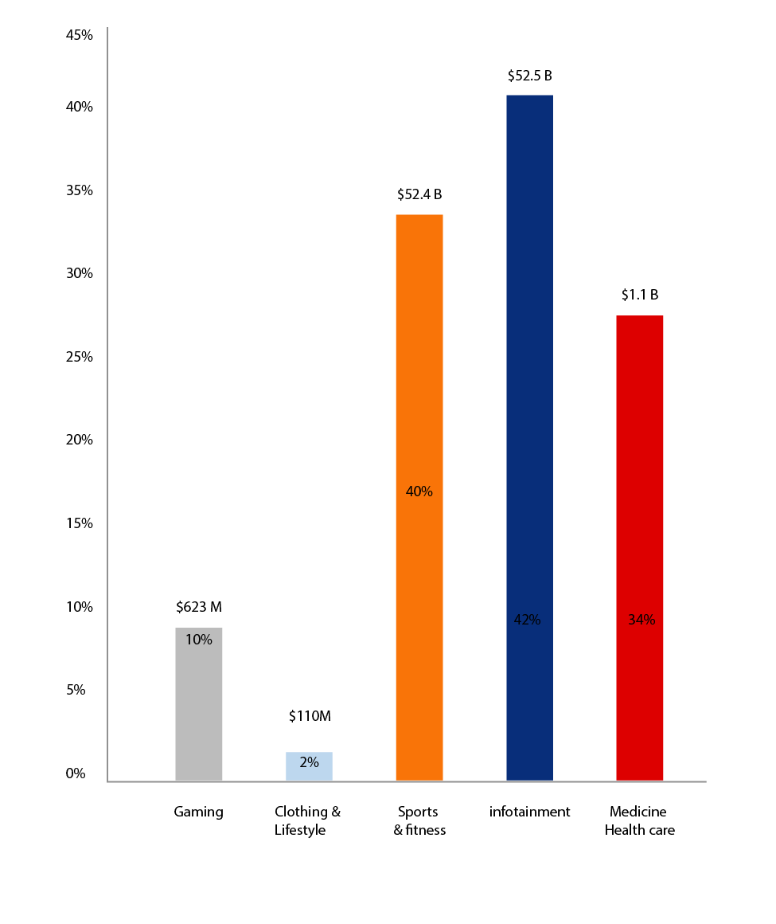
8) Market Segment of Wearable
Market size by application

Slide 13
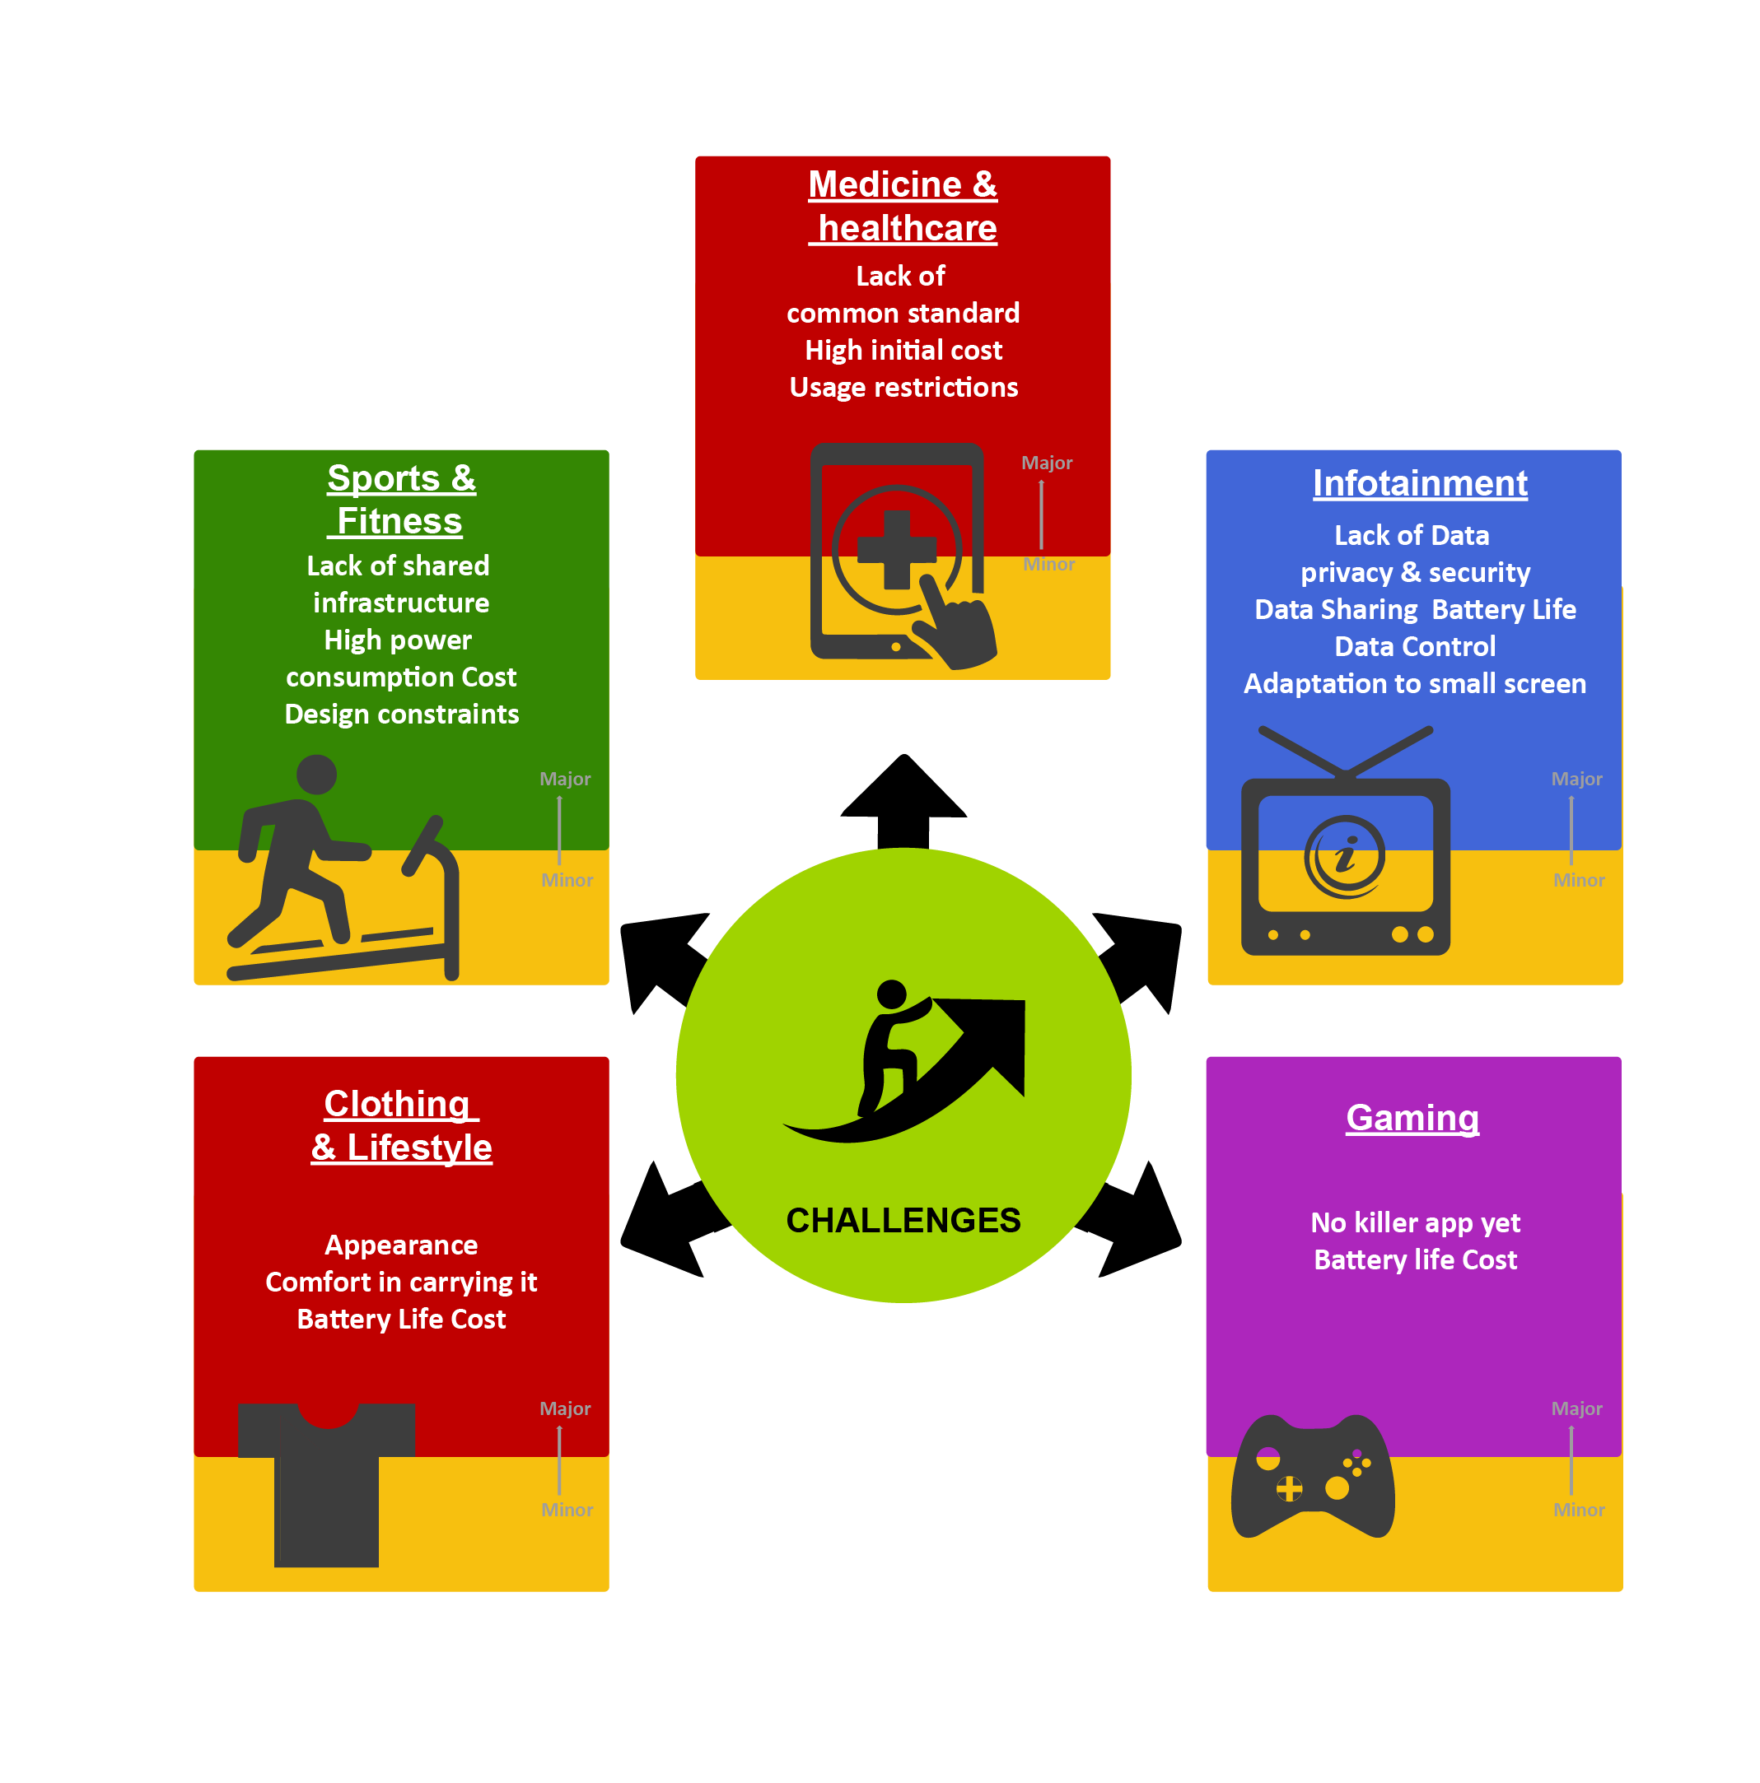
9) Major Challenges in Wearable Eco-System
Major Challenges

Slide 14
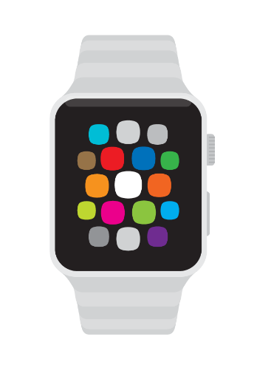
9) Major Challenges in Wearable Eco-System
Challenges for
Component providers
Challenges for
Product Providers
Challenges for Wearable
Application Providers
Standards Compliance , correct estimation of size , weight and display of product
Development cost of application is
very high
Big Challenges to build Cross-Platform
Application and interconnect device
Availability of products
at affordable price points
Immature and fragmented market ,
lack of standards
Product Weight a big challenge .
Frequent Application upgrades ,
Integration between Apps and Sensors
Wearables knowledge good in Fitness and Health Segment. Other domains are void regarding the resources
Reaching the right End User
Market demands for intelligent ,durable ,
water-proof products
Power Consumption ,
size and weight of device
Dearth of Knowledgeable and
experienced resources
Data Security ,
Application Integration
Fragmented Ecosystem
High Competition
in a Fragmented Market

Slide 15
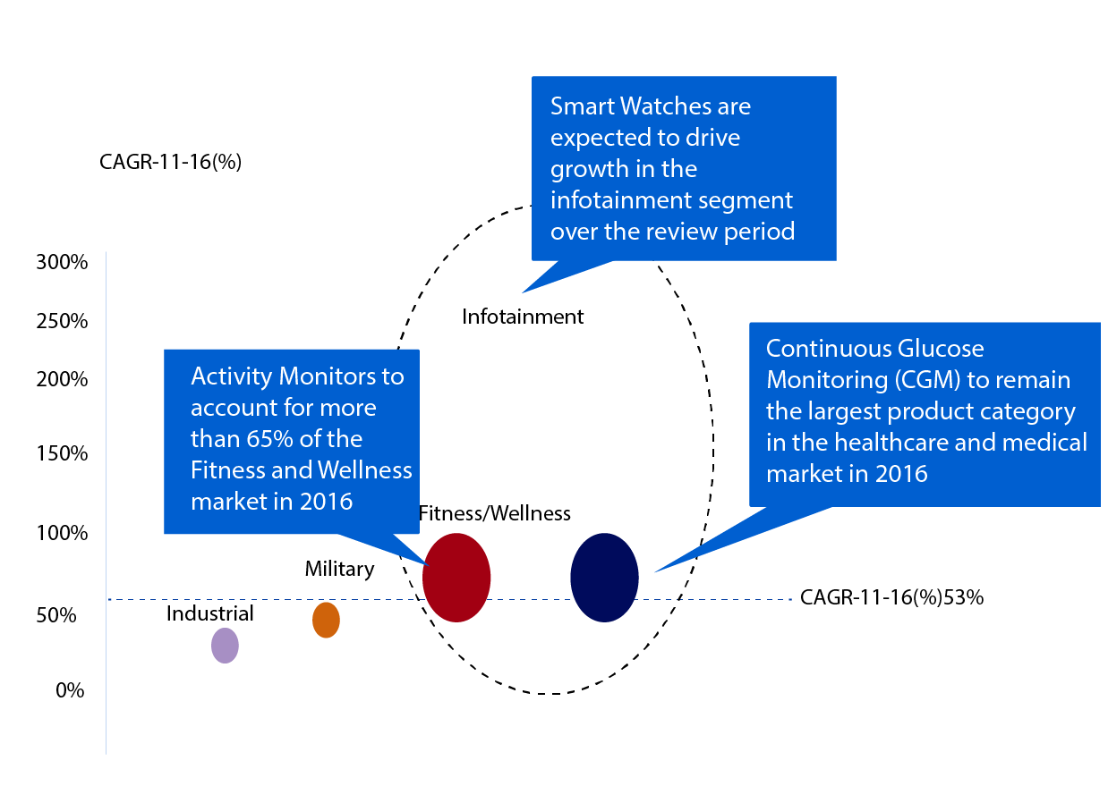
10) Wearable Opportunity and Market Perspective
According to a survey conducted in October and November 2013, across six major countries: Australia, Canada, India, South Africa, the United Kingdom, and the United States , there were few major Highlights ( Source : WearableTechWorld )
Among the six countries surveyed, very interestingly consumers in India were most interested in wearable technology:
80 % are interested in buying fitness monitors;
76 % percent are interested in smart watches;
74 % percent are Internet-enabled glasses.
Across all countries consumers are generally excited about the following:
46 % percent think smartwatches are of value;
42 % percent Internet-connected glasses.

Slide 16



11) If Wearable potential is realized, these 6 Industries are poised to capitalize
  73 percent expect wearable technology to make media and entertainment
  experiences “more immersive and fun.”
  They’re not looking to wearables “to create new genres of communication and entertainment--but rather to improve those already in existence,” according
  to the report.
If your business is in
one of the following six industries PwC says it’s best poised to take advantage of the Wearable trend, it’s high time you should give Wearable the due respect it deserves in your Strategy for current Fiscal Year
Entertainment
  Help health-conscious people monitor everything from calories consumed
  and burned to steps taken to sleep
Social Media
  76 percent says they’d like to use wearable tech for more “pleasant, efficient” shopping experiences -- from pre-store , in-store product and deal research and comparison, all the way to the checkout
Gaming

Slide 17


If Wearable potential is realized, these 6 Industries are poised to capitalize
  More Wearables screens gives more scope to the marketers
  More Customized , Targeted and Engaging Advertisement
If your business is in
one of the following six industries PwC says it’s best poised to take advantage of the Wearable trend, it’s high time you should give Wearable the due respect it deserves in your Strategy for current Fiscal Year
Advertising
  Help health-conscious people monitor everything from
  calories consumed and burned to steps taken to sleep
Health
  76 percent says they’d like to use wearable tech for more “pleasant, efficient” shopping experiences -- from pre-store , in-store product and deal research and comparison, all the way to the checkout
Retail

Slide 18
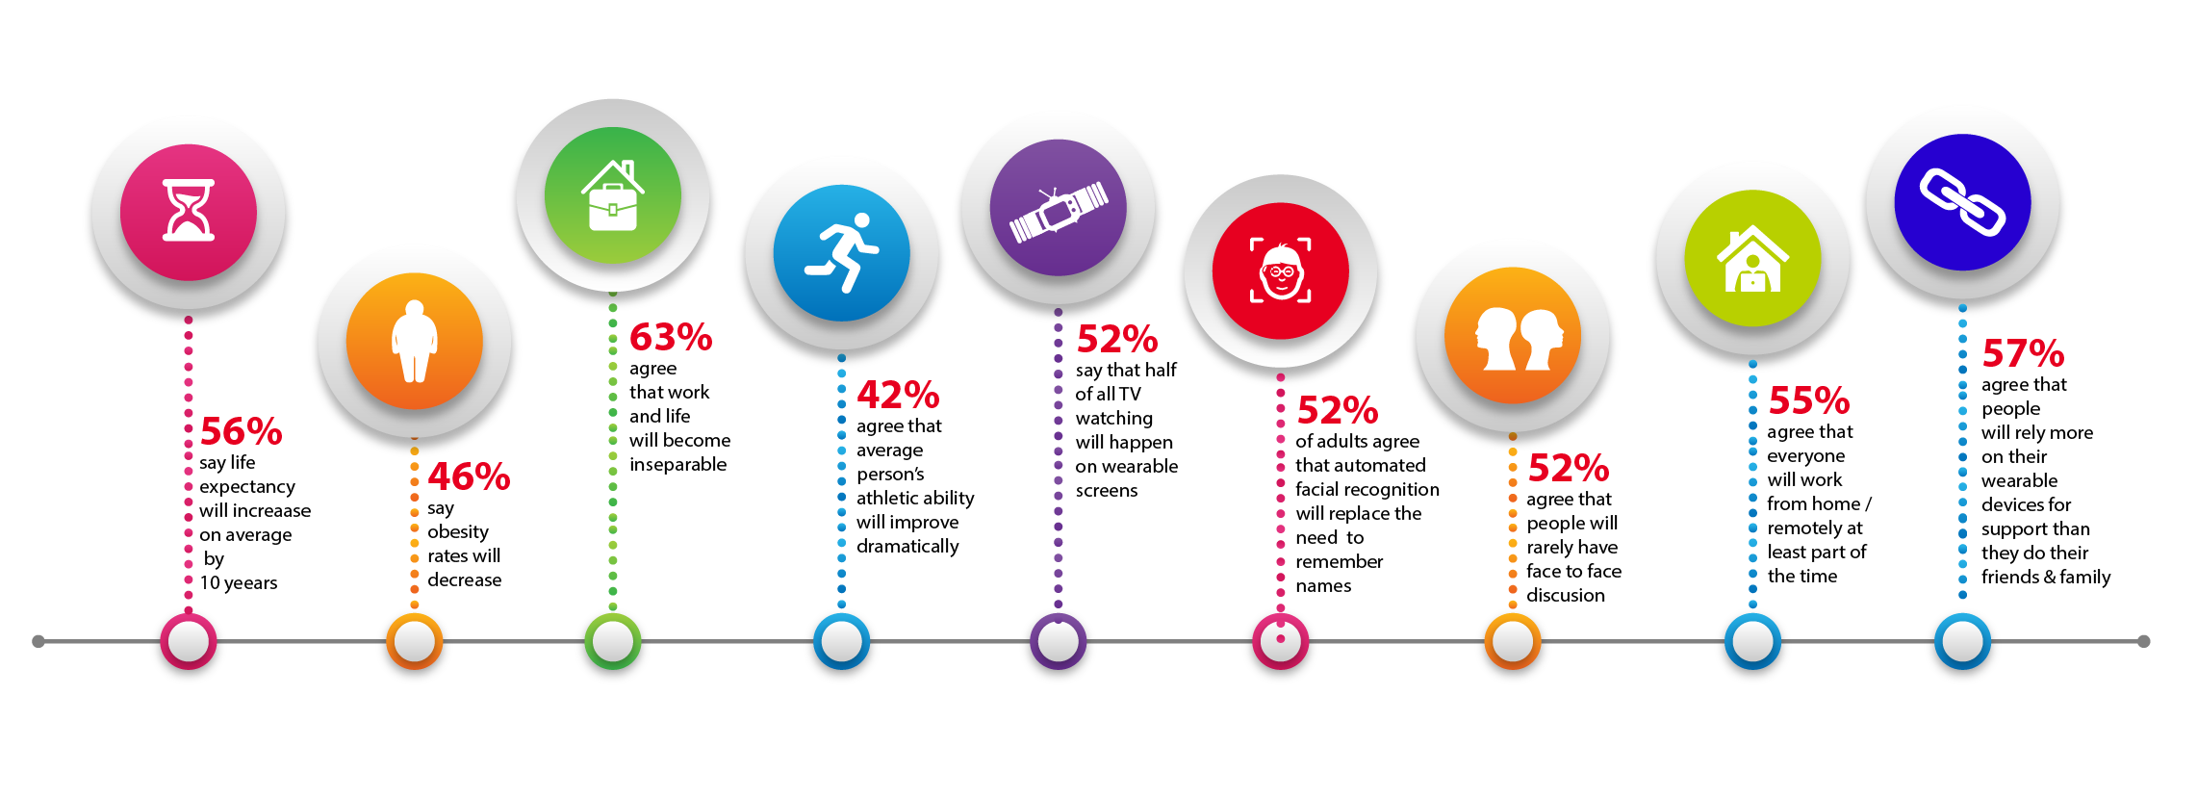
12) Future of Wearable Technology
Future of Wearables

Slide 19
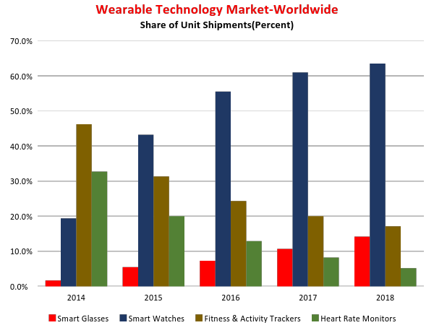
Future of Wearable Technology
Long Distance Togetherness
Data Streamed Care
Emotional Mirror
Biometrically Attuned
Responsive Coaching
Bespoke Biotech
CONNECTED INTIMACY
(Person to Person)
THE FUTURE OF WEARABLE TECH
Augmented Sensory Perception
Authenticated
Self On-Board Interface
Cloud Memory
TAILORED ECOSYSTEM
(Person to Computer)
CO-EVOLVED POSSIBILITIES
(Person as Computer)

Slide 20


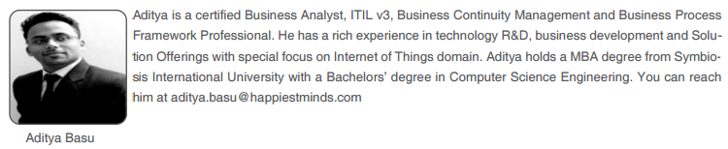
About The Author
Thank You
E-mail: Business@happiestminds.com
Visit us: www.happiestminds.com

